Slide 1
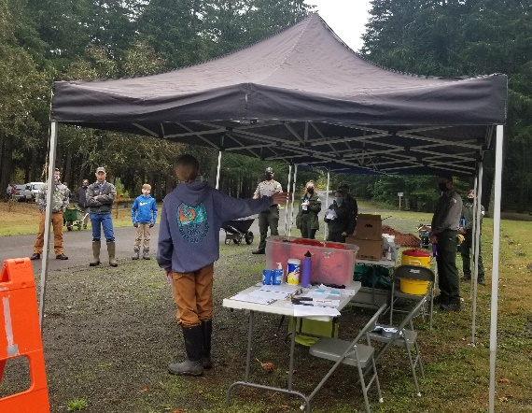
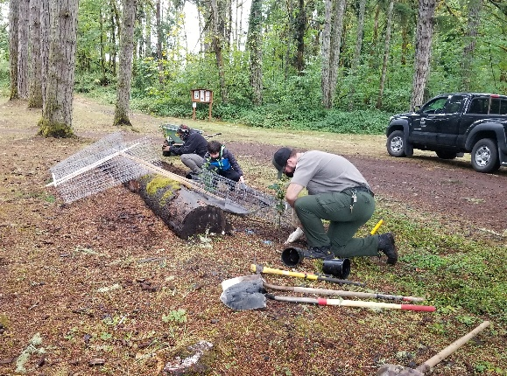
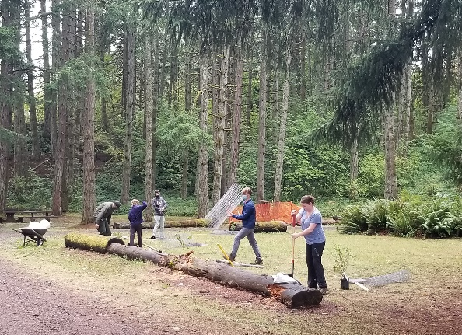
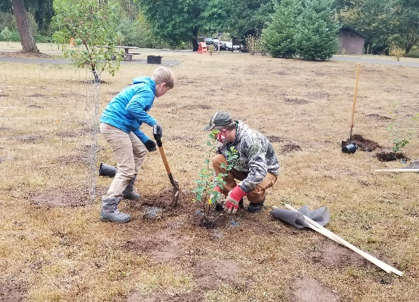
2020 WVP national public lands day OPERATIONS DIVISION, Portland district, Northwestern division
WHO: Willamette Valley Project
WHAT: National Public Lands Day
WHEN: Saturday, September 26
WHERE: Schwarz Campground, Dorena Lake, Oregon
WHY: National Public Lands Day is a nation-wide event in which thousands of volunteers assist in projects to improve federal lands. 30 volunteers planted 48 trees and shrubs to improve the aesthetics and habitat in the campgrounds.
WHAT’S NEXT: Corps volunteers will water and care for the new plants until they are well-established. WVP rangers will continue to host NPLD events in future years, perhaps in a different location next year.
Before the work began, Eagle Scout Zane provided an orientation and safety talk to the volunteers.
Park Ranger Ian McBride helped volunteers plant trees and shrubs in the campground.
28 volunteers from scout groups planted native trees and shrubs in Schwarz Campground.
Summary:
On Saturday, September 26, a National Public Lands Day volunteer event was held at Schwarz Campground at Dorena Lake. 7 Corps park rangers, 1 Corps botany tech, 2 Corps volunteers, and 28 community volunteers participated. Due to COVID-19, the event was limited to local scout groups who have participated in the event in the past. Volunteers planted 48 trees and shrubs. The goals of the project were to add shade and visual barriers in the campground, improve aesthetics, and increase habitat for pollinators and wildlife. Some of the new vegetation replaced trees and shrubs that were damaged in the severe winter storm of 2019. The value of service provided by the volunteers was about $2,448.

